Slide 1
Brand Positioning III

Slide 2
Overview
Positioning Approaches
Brand Personality
Brand Authenticity
Brand Nostalgia

Slide 3
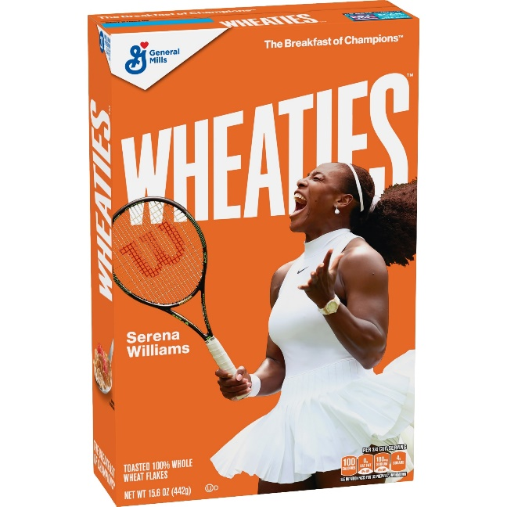




Positioning Approaches
Product feature
Product benefit
User category
Usage situation/application
Against other brand
Against product category

Slide 4
Beyond Features and Benefits: Brand Personality
Brand Personality: “a set of human characteristics associated with a brand”
- J. Aaker, 1997

Slide 5





Facets of Brand Personality
Sincerity
  down-to-earth, honest, wholesome, cheerful
Excitement
  daring, spirited, imaginative, up-to-date
Competence
  reliable, intelligent, successful
Sophistication
  upper class, charming
Ruggedness
  outdoorsy, tough

Slide 6

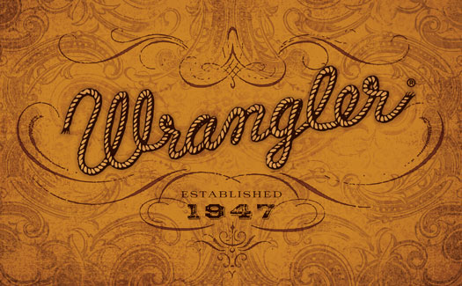
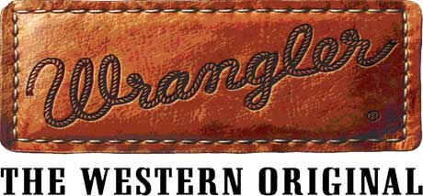
Brand Authenticity
At its heart, brand authenticity is about practicing what you preach; being totally clear about who you are and what you do best.

Slide 7



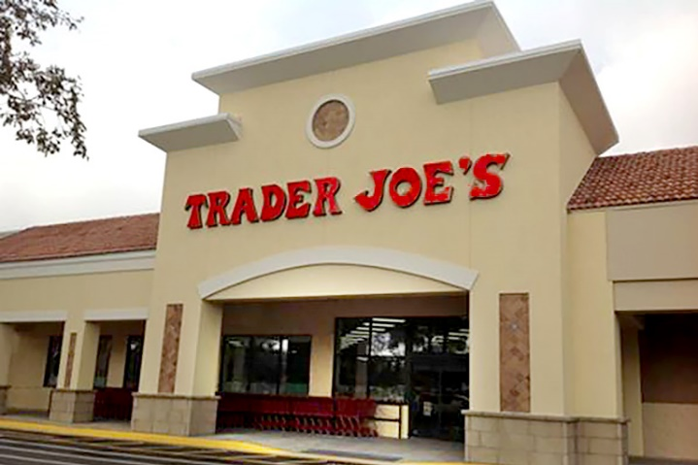

Genres of Authenticity
Original
Natural
Exceptional
Referential
Influential

Slide 8

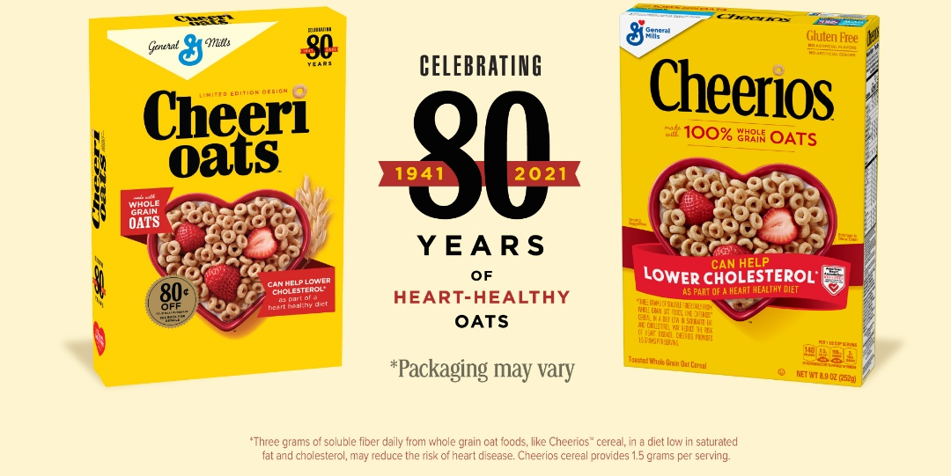
Brand Nostalgia
Sometimes used by “classic” brands
Sustainable vs. newer competitors
Can be another “reason to buy”
Need to avoid brand “egocentricity”

Slide 9
Conclusion
What positioning approach does your brand use?
Does your brand have a personality?
Is your brand “authentic”?

Slide 10
End of Lecture

